Slide 1

School of Computing Science and Engineering
Course Code: BCS01T1001 Course Name: Data Analytics (Excel and Tableu)
Unit – 2
Manipulation of Excel Data
Faculty Name: Mr. Soumalya Ghosh Program Name: B.Tech CSE

Slide 2
Objectives
Charts
Pivot Tables

Slide 3
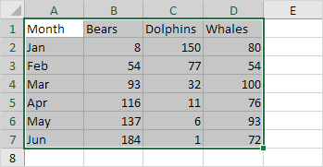
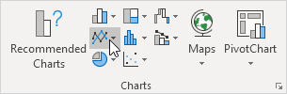
Charts
A simple chart in Excel can say more than a sheet full of numbers.
To create a line chart, execute the following steps.
Select the range A1:D7.
On the Insert tab, in the Charts group, click the Line symbol.

Slide 4
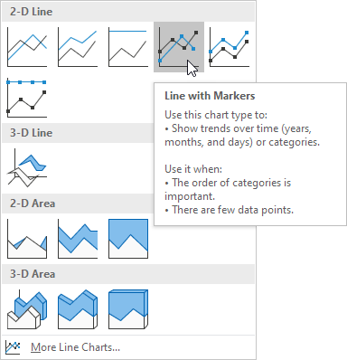
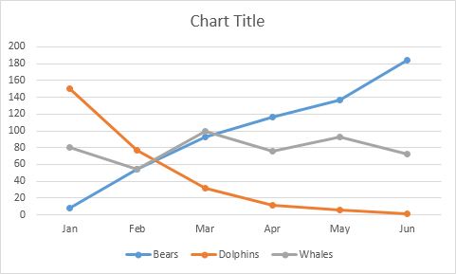
Charts
Click Line with Markers.
Result

Slide 5
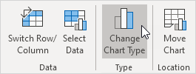
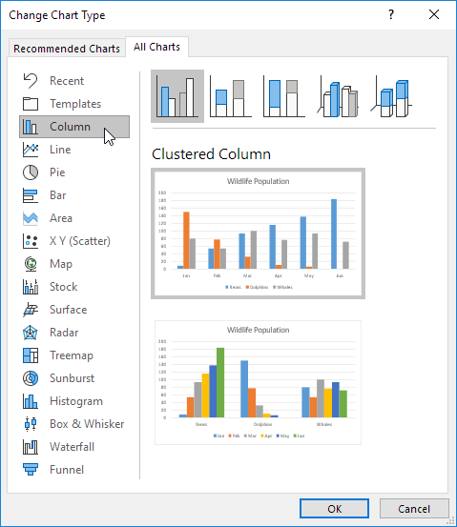
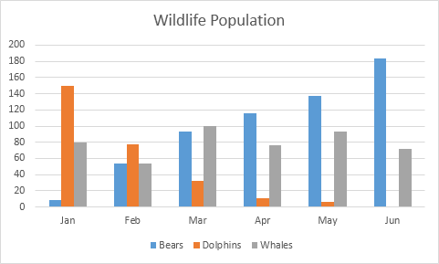
Charts
Change Chart Type
Select the chart.
On the Design tab, in the Type group, click Change Chart Type.
On the left side, click Column.
Click OK
Result:

Slide 6
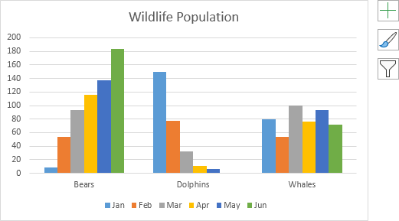
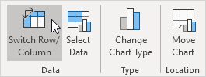
Charts
Switch Row/Column
If you want to display the animals (instead of the months) on the horizontal axis, execute the following steps.
Select the chart.
On the Design tab, in the Data group, click Switch Row/Column.
Result:​

Slide 7
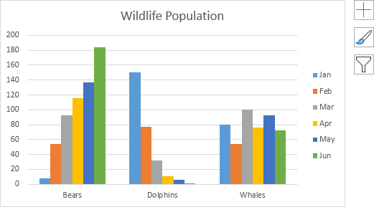
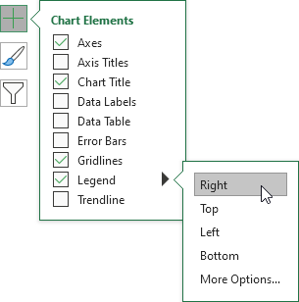
Charts
Legend Position
To move the legend to the right side of the chart, execute the following steps.
Select the chart.
Click the + button on the right side of the chart, click the arrow next to Legend and click Right.
Result:​

Slide 8
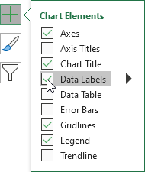
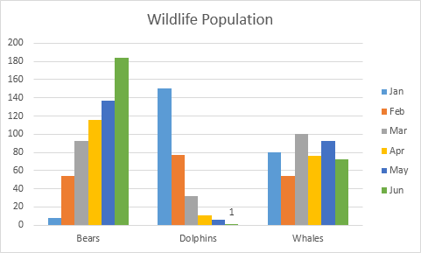
Charts
Data Labels
You can use data labels to focus your readers' attention on a single data series or data point.
Select the chart.
Click a green bar to select the Jun data series.
Hold down CTRL and use your arrow keys to select the population of Dolphins in June (tiny green bar).
Click the + button on the right side of the chart and click the check box next to Data Labels.
Result:​

Slide 9
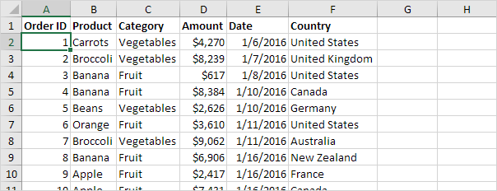
Pivot Tables
Pivot tables are one of Excel's most powerful features. A pivot table allows you to extract the significance from a large, detailed data set.
The data set consists of 213 records and 6 fields. Order ID, Product, Category, Amount, Date and Country.

Slide 10
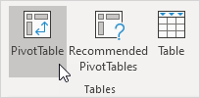
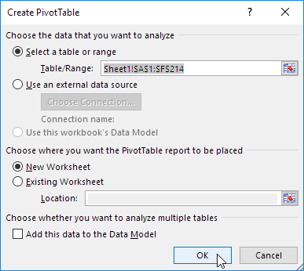
Pivot Tables
Insert a Pivot table
To insert a pivot table, execute the following steps.
Click any single cell inside the data set.
On the Insert tab, in the Tables group, click PivotTable.
Excel automatically selects the data for you. The default location for a new pivot table is New Worksheet.
Click OK

Slide 11
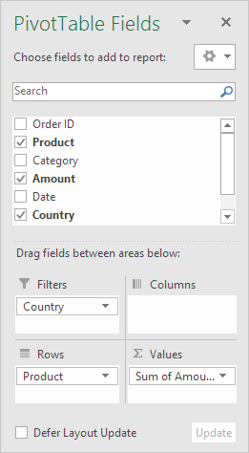
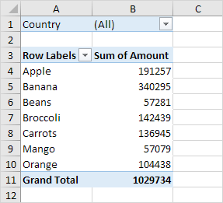
Pivot Tables
Drag fields
The PivotTable Fields pane appears. To get the total amount exported of each product, drag the following fields to the different areas.
Product field to the Rows area.
Amount field to the Values area.
Country field to the Filters area.
Result: Bananas are our main export product. That's how easy pivot tables can be!

Slide 12
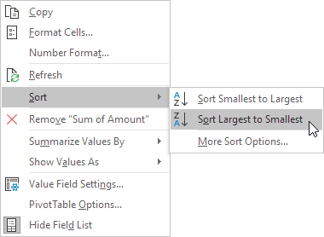
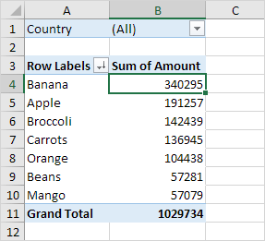
Pivot Tables
Sort
To get Banana at the top of the list, sort the pivot table.
Click any cell inside the Sum of Amount column.
Right click and click on Sort, Sort Largest to Smallest.
Bananas are our main export product. That's how easy pivot tables can be!

Slide 13
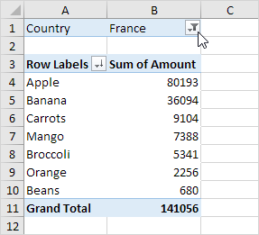
Pivot Tables
Filter
Because we added the Country field to the Filters area, we can filter this pivot table by Country. For example, which products do we export the most to France?
Click the filter drop-down and select France.
Result: Apples are our main export product to France.

Slide 14
References
Borle, S. Introduction to Data Analysis Using Excel [MOOC]. Coursera. https://www.coursera.org/learn/excel-data-analysis

Slide 15
Questions?
Write your queries to
Soumalya.ghosh@galgotiasuniversity.edu.in​

Slide 16


